Slide 1

Research Experience
Xu Han
M.I.T. Computer Science
Queensland University of Technology
Notes:
Now, let’s get started the presentation

Slide 2
PROJECT
Textual Tweets Clustering based on User’s Interests:
A Comparative Study of K-Means, DBSCAN, and Hierarchical Agglomerative
Clustering Schemes
Individual Research
July 2020-October 2020

Slide 3
Volume: the size of data
Velocity: the speed of data being generated
Introduction
Research Background
Twitter has 145 million active users, who can post 500 million tweets daily
The large-scale data stimulates many researchers on improving the quality of Personalised Recommendation Systems
Classification methods (Supervised Learning) prevalently apply to categorise tweets based on user’s interest
Technical Gap
Be endless to annotate tweets into various domains for the preparation of training data
Usually need to solve overfitting or underfitting problems
Be unable to be adaptive to large volume and velocity of Twitter’s dataset
Potential Solution
Employ unsupervised learning approaches for alternatives
Text clustering: K-Means, DBSCAN & HAC
Vectorisation: TF-IDF
Evaluation: Silhouette Coefficient

Slide 4
Introduction
Research Objectives
Build up the clustering models to achieve tweets clustering in accordance to user’s interests
Present a comparative analysis to model performance & limitations (New Knowledge)
The research will answer the question:
How could establish a model for K-Means, DBSCAN, and HAC algorithms to a comparative analysis for exploring their clustering performance and limitations in an unlabeled Twitter’s dataset?

Slide 5
Research Methods
4
Tweets Clustering
1
Unsupervised
Schemes
Data Collection
Noise Clean
Tokenization
Stopword Removal
Lemmatization
Silhouette Coefficient
K-Means
MySQL
Evaluation
Pooling Dataset
Pre-process
TF-IDF
DBSCAN
Proximity Measure
Tweet Pooling
Euclidean
Virtualization
HAC
Dataset: 720 Users & 2627 tweets
Data Quality
Improvement
Tweets Vectorization
Result Analysis
2
3
5

Slide 6
Research Methods
Pre-process
1. Noise Clean
Eliminate Non-English
Remove URLs, Email, User Mentions (@), digits, ‘RT’
Remove Special Characters, e.g. Emoticons
2. Tokenization
Decipher tweets into single words (index) & eliminate delimiters
Casefold (lowercase)
3. Stopword Elimination
Remove non-meaningful words, e.g. this, which, in, etc.
Remove when the length of a word <= 2
4. Lemmatisation
Map and decompose various forms of a word to its basic form
Original Tweets
It's so nice out. It almost makes me want to go for a walk.
How to take a photograph on a 5x4 camera #gear #camera #howto https://t.co/nEAC6lam
Processed Tweets
nice almost make want walk
take photograph camera gear camera howto
Document-Term Matrix
Index | nice | almost | … | howto
0 | 0.43 | 0.43 | … | 0
1 | 0 | 0 | … | 0.43

Slide 7
Research Methods
Hyperparameter Configuration
Approach | Params | Detective Method
K-Means | K (the number of clusters) | Elbow Method
DBSCAN | Eps & Min_sample | Grid Matrix
HAC | Non-parametric algorithm | Elbow Method
Best Model Eps = 0.2 & Min_sample = 2
 | Min_sample
Eps |  | 1 | 2
 | 0.1 | 0.01 | 0.32
 | 0.2 | 0.34 | 0.4
Also use Elbow to find the optimal K
Silhouette Score

Slide 8

Research Methods
Silhouette Coefficient
Silhouette coefficient is a method used for measuring how a sample is close to its belonging cluster.
a(i) = the average dissimilarity of i point
b(i) = lowest average dissimilarity of i point
Range: -1 ≦ s(i) ≦1, where
s(i) is close to 1, the a sample in the cluster is well-clustered. [Good]
s(i) is close to -1, the a sample may not be well-configured to its belonging cluster. [Bad]

Slide 9
Result & Discussion
K-Means is the best clustering method, with the three optimal K values [6, 233, 7].
DBSCAN contributes to 233 clusters and 1585 Noise Points.
HAC is close to K-Means when K value increases to 233
Table 1: K = 6
 | K-Means | HAC
SC (Avg) | 0.0421 | 0.0051
Epsilon = 0.7 & Min_sample = 2
1585 Noise Points Detection
 | K-Means | DBSCAN | HAC
Optimal K | 6 | 233 | 7
SC (Avg) | 0.0421 | 0.0361 | 0.0062
Table 2: K = 233
 | K-Means | HAC
SC (Avg) | 0.1421 | 0.1381
K-Means & HAC
The increase to K is associated with the growth of SC (Avg), which indicates the sparse dataset is preferable to form many sub-clusters.
Table 3: K = 7
 | K-Means | HAC
SC (Avg) | 0.0434 | 0.0062
SC (Avg) = Average Silhouette Score
K = the number of clusters

Slide 10
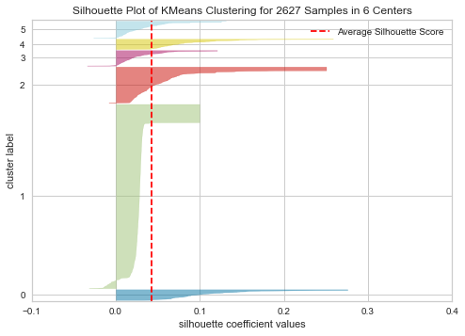
Result & Discussion
Visualise the best model ‘K-Means’ (optimal K = 6)
The sample distribution is unaveraged to the 6 clusters
Cluster 1 is the larger group, but numerous samples are less than SC(Avg)
Cluster 0 and 4 are the better ones, as most samples are over to SC (avg)

Slide 11
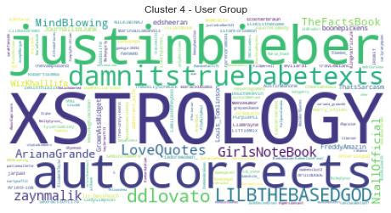
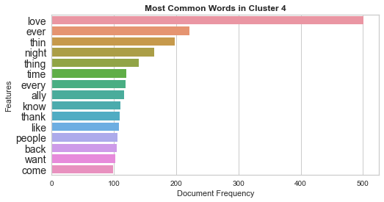
Result & Discussion
Visualise the best cluster 4 generated by the best model
Top-10 frequent terms:
{love, ever, thin, night, time, every, ally, know, thank, like, people, back, want, come}
User Group with names:
{autocorrects, XSTROLOGY … justinbieber}
Easy to group users who have the similar interest
Verbs are frequently appeared, but they are not beneficial to analyse
BUT, hard to interpret the real topic

Slide 12
Result & Discussion
Findings | Description | Improvement
Performance | The increase to K number is associated with the growth to Silhouette Score, in terms of K-Means and HAC, but it harms efficiency. | -
Experimental Params | Difficult to discover optimal hyperparameters for K-Means and DBSCAN | -
TF-IDF | TF-IDF fails to weight the natural tweets, as they are always short-length and noise. Short-Text: TF-IDF is sensitive to the document length, but the processed tweet usually contains a few of words. The term frequency is usually 1 or 2, which may adversely affect the weight of a term. | Replace TF-IDF to doc2Vec, which can fix the length of a vector, enabling it to be dense
Pre-processing | Fail to match the words that are informal expressions or mis-spelling (e.g. reaaaaally ⬄ really) | Bing spell check API
Topic interpretability | Difficult to recognize the real topic. | Improve model performance and observe

Slide 13
Conclusion
Answer the research questions [Performance & Limitations]
K-Means is the best model, but it is limited to define K value.
DBSCAN can be helpful to identify noise points (see DBSCAN in Appendix), but the definition of Eps and Min_Sample is challenging work.
HAC is the worst model, but it can be improved by increasing K value.
They are not applicable to clustering tweets currently, but there have many measures to improve.
Improvement & Future Work
Replace TF-IDF toCheck doc2Vec
Add Misspelling to Pre-processing step
Improve Cluster quality for Topic Interpretability

Slide 14
PROJECT
Siamese Network
Collaborative Research (1st Author, 3 Persons)
July 2020-October 2020

Slide 15

Introduction
Research Background
A most fundamental research on Image Recognition & Computer Vision
Require to implement Siamese Network with Conventional Neural Networks
Regularisation L1/L2, Dropout, Early Termination applied to reduce overfitting
Equip the model with the generalisation capability in predicting the similarity of a pair of unseen images
The experiment was conducted on Google Colab with GPU

Slide 16
Research Methods
Loading Dataset
The Fashion-MNIST dataset contains 70,000 clothing images with 28 x 28 Grayscale, the classes of which include top, trouser, pullover, dress, coat, sandal, shirt, sneaker, bag, and ankle boot.
Dataset Separation
Image Reshape [batch size, rows, columns, channels]
Normalisation [0, 1]
Image Pair Creation
Pre-process
CNN1
CNN2
CNN1 = CNN2
Siamese Network
Training
Euclidean Measure
Evaluation
Virtualisation
Training Process
Result Analysis

Slide 17


Research Methods
Dataset Separation
Set | Labels | Proportion of Dataset | Purpose
1 | Top, Trouser, Pullover, Coat, Sandal, Ankle Boot | 80% : 20% | Training : [Validation & Evaluation]
2 | Dress, Sneaker, Bag, Shirt | － | Evaluation
3 | Set 1 ∩ Set 2 | 100% | Evaluation
Distribute an equivalent percentage of classes between training & testing datasets to Set 1
Use Set 1 (80%) to train the model, 20% of which is for validation to observe the training process
Divide unseen images from the original dataset into Set 2
Tap Set 1, 2 (unseen images) and 3 to evaluate model performance
Image Pair Creation
The above datasets will be reformed to new datasets required by Siamese Network
Positive Pair
Negative Pair

Slide 18
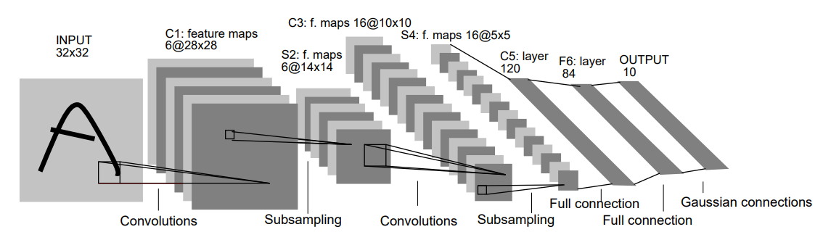
Research Methods
Baseline Model Creation (LeNet-5 Layer)
Network Architecture for Modified LeNet-5 Model
Layer | Name
1 | Conv2D
2 | MaxPooling
3 | Conv2D
4 | MaxPooling
5 | Flatten
6 | Full Connection
7 | Full Connection
8 | Full Connection (Output)
Create the basic model with LeNet-5 Architecture
ReLu
Model Configuration
Detect the suitable hyperparameters with the GridSearchCV method
Configure the model according to the below table
PARAMETERS : | Candidate value
Dense layer size : | 120
Filter size : | 32
Kernel size : | 3 x 3
Pooling size : | 2 x 2
Softmax

Slide 19
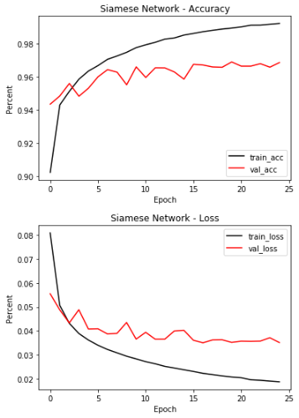
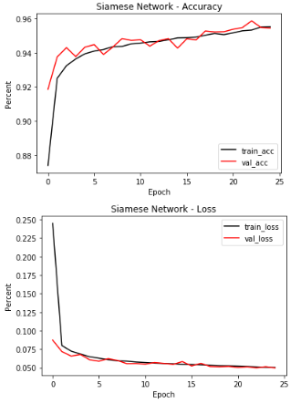
Result & Discussion
Baseline Model with
with default configurations
Improved Model with
L1:0.01 & L2:0.01, Dropout : 0.25
Overfitting occurs initially during the training process
No overfitting appears, but there is no significant improvement after 20 Epoch
The ‘Good-Fit’ model is selected by the combinative techniques,
i.e., L1/L2 (0.01), Dropout (0.25) and Early Termination (20 Epoch).

Slide 20
Result & Discussion
Network Architecture for Improved Model
Layer | Name
1 | Conv2D
… | …
6 | Full Connection
7 | Dropout
… | …
Baseline Model (BS) | \
Dataset | Accuracy (%) | Loss (%)
Set 1 (6-class) | 97.03 | 2.64
Set 2 (4-class) | 62.12 | 42.92
Set 3 (10-class) | 80.94 | 20.66
L1: 0.01
L2: 0.01
Improved Model (IM)
Dataset | Accuracy (%) | Loss (%)
Set 1 (6-class) | 95.63 | 4.97
Set 2 (4-class) | 65.14 | 24.04
Set 3 (10-class) | 81.98 | 14.48
Evaluation
Randomly Drop 25% Neurons
L1/L2 and Dropout are added to the original model (6 & 7 Layer respectively) for evaluation.
Both models are evaluated on three datasets for the performance comparison.
Set 1: BS > IM
Set 2 (unseen images): IM > BS
Set 3 (all classes): IM > BS
In terms of predicting unknown images, IM is better than BS, which indicates that solving overfitting can improve model performance, possibly enabling it to have generalisation capability.
The accuracy of IM to Set 2 is not desirable.

Slide 21
Conclusion
Research Findings
The approaches, i.e., L1/L2, Dropout and Early Termination, are demonstrated on improving model performance.
By solving the overfitting problem, the model is more robust when handling uncertain data.
The NEW model is not with generalisation capability, because its performance is not acceptable.
New Knowledge
CNN -> identify features from still images, but things get more difficult to videos.
RNN -> an alternative way to CNN to deal with items changed over time.
Improvement & Future Work
Employ Confusion Matrix for visually observing the process (training or prediction)
Testing on Extreme scenario (e.g., remove all positive cases for training & testing)
Experiment on images with RGB-Color

Slide 22
Thank You

Slide 23
Appendix
TF-IDF
TF-IDF is the abbreviation of Term Frequency-Inverse Document Frequency, used for converting the text-based content into numerical representation, called Vector. The method is reliant on a numerical statistic method to calculate the weight for a term, that reflects how the importance of a single term to a document in an entire dataset (collection).
wij = log(fij)× log(N / nj)
w_{ij} : the weight of the term j in document i
f_{ij} : the number of occurrences of term j in document i (TF)
N : the total number of documents (tweets).
n_{j} : the number of documents in which term j (DF)
Apply the two hyperparameters to reduce dimensionality & obtain frequent terms
Max Features (MF) = 800
Only consider the top-800 terms ordered by term frequency in decreasing order.
min_df (mDF) = 10
Ignore terms that have a document frequency strictly lower than the given threshold.
TF-IDF with default settings | TF-IDF with 800 MF and 20 mDF
n_samples: 2627, n_features: 4578 | n_samples: 2627, n_features: 307

Slide 24
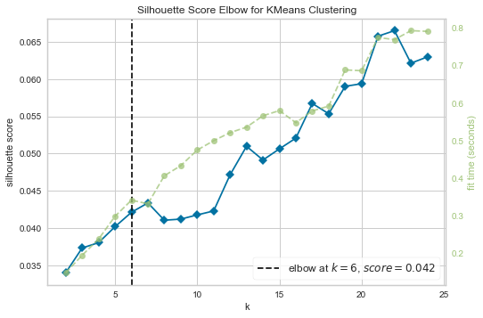
Appendix
Elbow Method
Discover the optimal K to K-Means, balanced on silhouette score and time expense.
K = 6, with SC(AVG) = 0.042

Slide 25
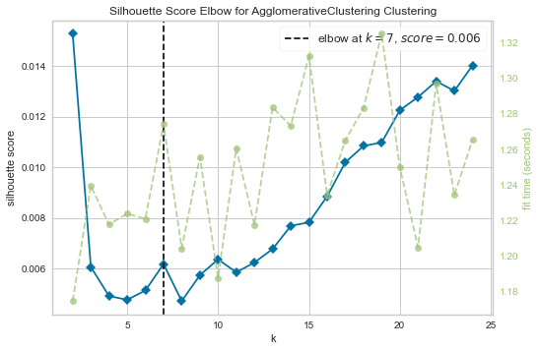
Appendix
Elbow Method
Discover the optimal K to Hierarchical Agglomerative Clustering, balanced on silhouette score and time expense.
K = 7, with SC(AVG) = 0.006

Slide 26
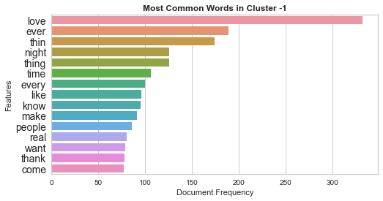
Appendix
DBSCAN Noise Points in Cluster -1
Top-15 Features
DBSCAN detects the top-10 noisy features in -1 cluster, including {love, ever, thin, night, time, every, like, know, make, people, real, want, thank, come}
Except the terms ‘love’ and ‘time’, many of them may not be meaningful, which could be removed.
Notes:
The result is not reliable, because performance to DBSCAN is not acceptable.

Slide 27
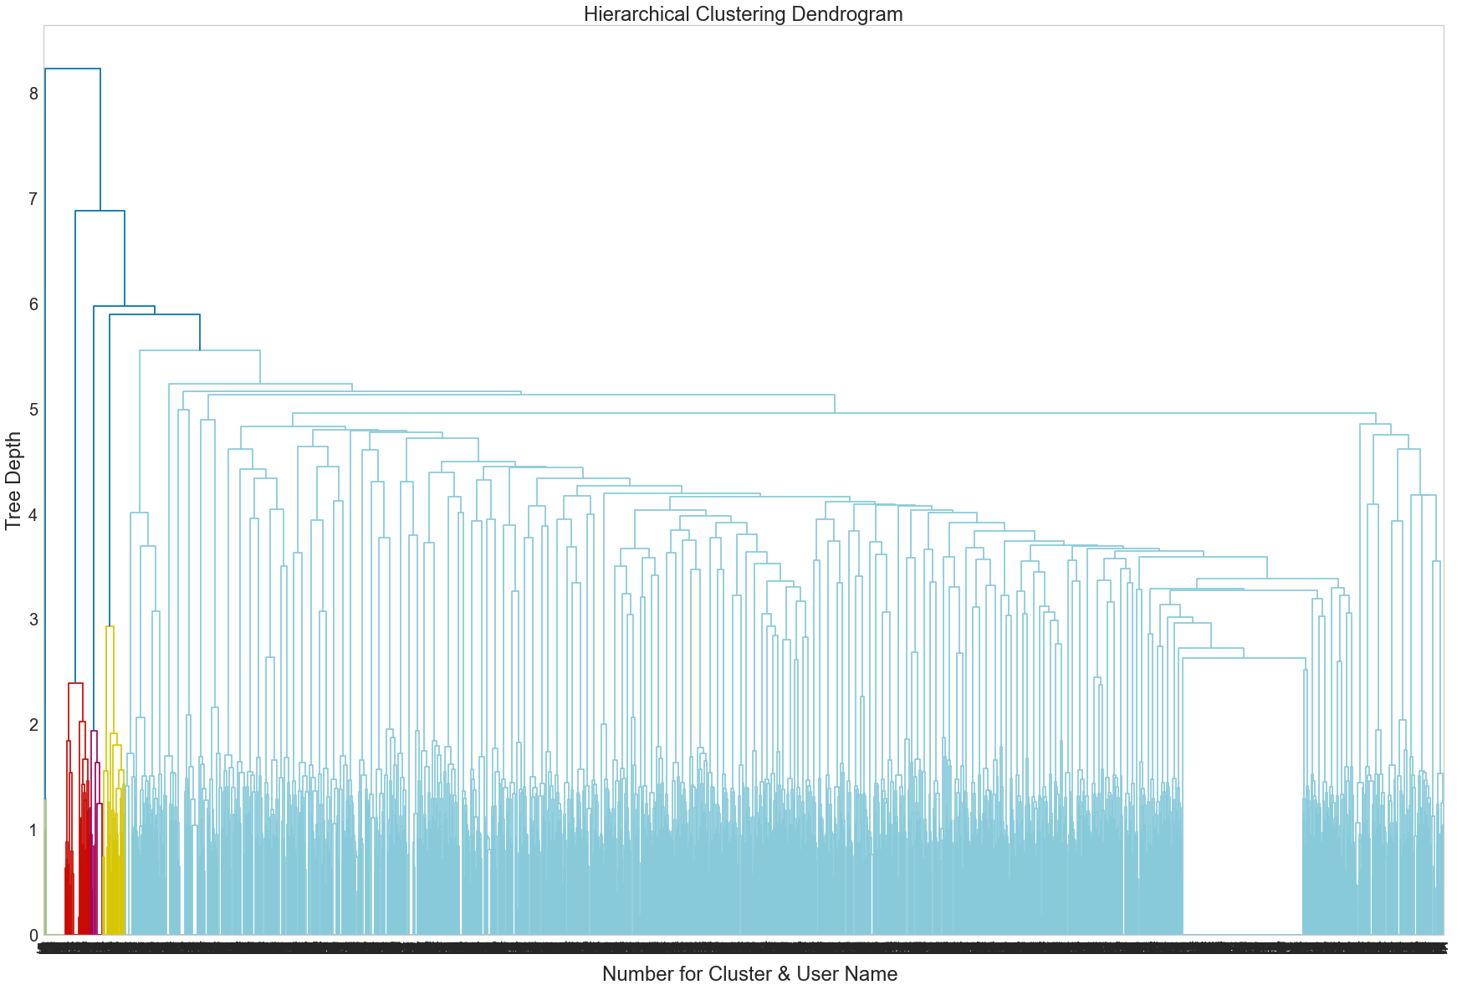
Appendix
HAC – Dendrogram (Full Tree)
The depth of this tree is approximate 9.
The tree-based virtualisation is able to represent the structure, but it cannot be interpretable to large size of data.

Slide 28
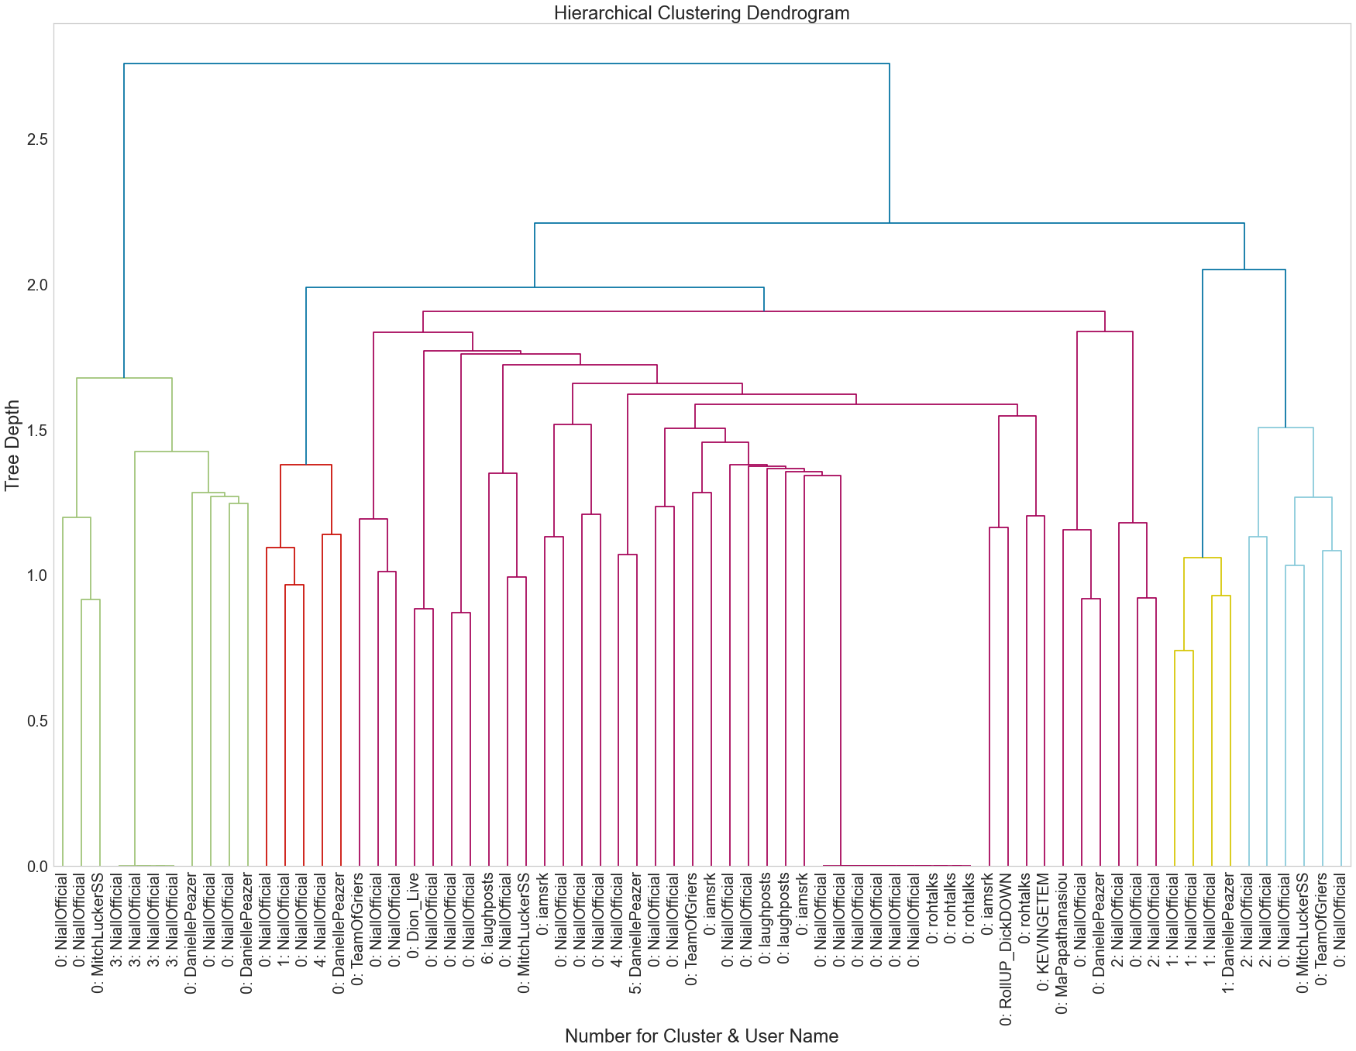
Appendix
HAC – Dendrogram (Small Tree)
The tree is generated with 70 tweets and their users.
The depth of the tree is approximate 3.
7 clusters [0, 1, 2, 3, 4, 5, 6]
Easily identify users, named ‘NiallOfficial’, MitchiLuckerSS, DaniellePeazer, etc., in cluster 0.
The user ‘NiallOfficial’ has many interests, reflecting in cluster 0, 1, 3, and 4.

Slide 29

Appendix
Group User Interest
Fetch terms and their weights in a cluster, based the clustered index.
Sum the weight of terms if they appear in the tweets of this cluster.
Remove the users whose weight = 0
Sort by the weighs in decreasing order
Example
Cluster 0: {apple: 0.4, fruits: 0.2, eat: 0.1, juice: 0.3}
User 1: [‘I like an apple’, ‘I like eat’]
User 2: [‘I dislike juice’, ‘I want to shopping’]
{User 1: 0.4 + 0.1}
{User 2: 0.3}
{User 1: 0.5, User 2: 0.3}
Notes:
If we have a cluster 0
We have many terms and their weights
Sum the weight of a term that appears in user’s tweets
For example,
We have cluster 0, two users
Apple and Eat is matched to User 1 in two different tweets.
We have the sum weight of User 1: 0.4 + 0.1
For User 2, only juice is matched, so the weight of this user is 0.3

Slide 30
Appendix
Top-15 Feature
1. Extract terms in the cluster, based the clustered index.
2. Statistic to each term that appears how many times in the collection (cluster)
3. Sort by the DF in decreasing order.
4. Fetch the top-15

Slide 31
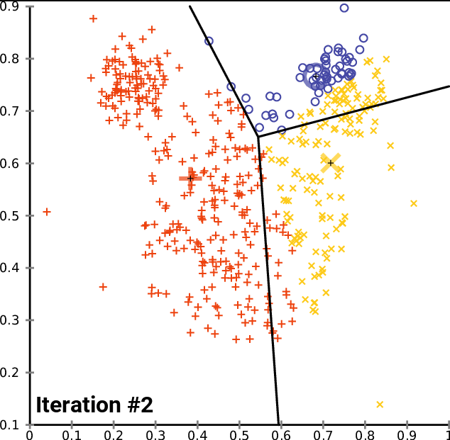
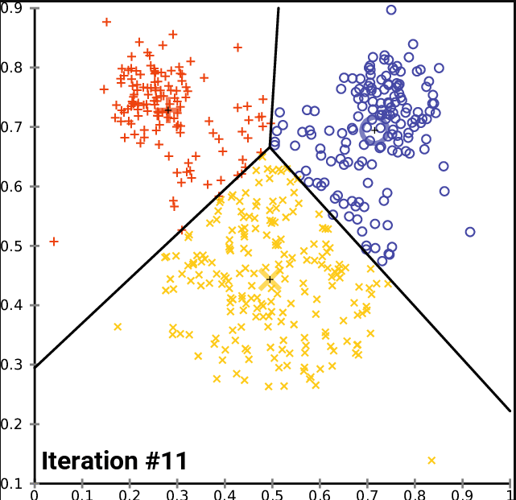
Appendix
K-Means
K-means is capable of dividing the data points into K clusters, where if points are highly similar (high intra-cluster distance), they are grouped into a cluster. The algorithm is converged when all points are well-clustered.
Be arbitrarily select K centroids as the initial clusters.
Perform the iterations:
Allocate the data points to the cluster, where each point is close to a centroid.
Re-locate the centroid points based on the mean of points in the clusters.
Converge when each point is optimally clustered.
Iterate to update
K clusters

Slide 32
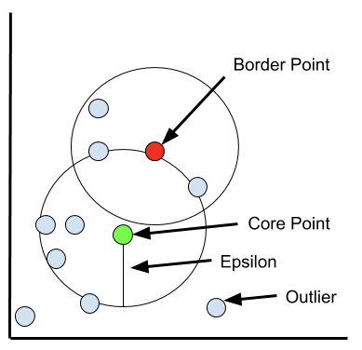
Appendix
DBSCAN
Density-Based Spatial Clustering of Applications with Noise (DBSCAN) can find arbitrary shaped clusters and clusters with noise, which is defined by Eps and minPts.
Eps (ε ): a range specifies the neighborhoods, where points in the range (inclusive) are considered to be neighbors.
minPts: minimum number of points to define a cluster.
Core Point: a centre point if the minPts number of points (include itself) in its neighboring area, within the radius eps. Centre points are connected.
Border Point: a border point defined by if it can be reachable from a core point, but the surrounding area contains the number of points that are less than minPst.
Outlier: an outlier defined by if it cannot be reachable from any core points.

Slide 33
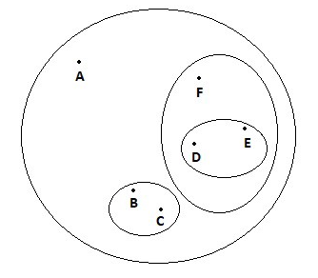
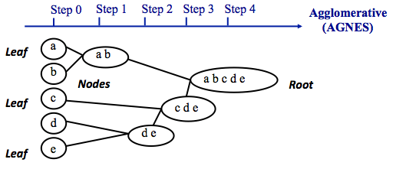
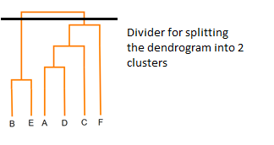
Appendix
Hierarchical Agglomerative Clustering (AGNES)
The agglomerative is a ‘bottom-up’ approach (AGNES).
Each object (tweet vector) starts by treating as a singleton cluster.
The pairs of sub-clusters are successively merged as one based on minimum their similarity.
Converge when all sub-clusters are merged into a tree-based representation (Dendrogram)
Dendrogram will be separated into clusters defined by K (if provided).

